Slide 1
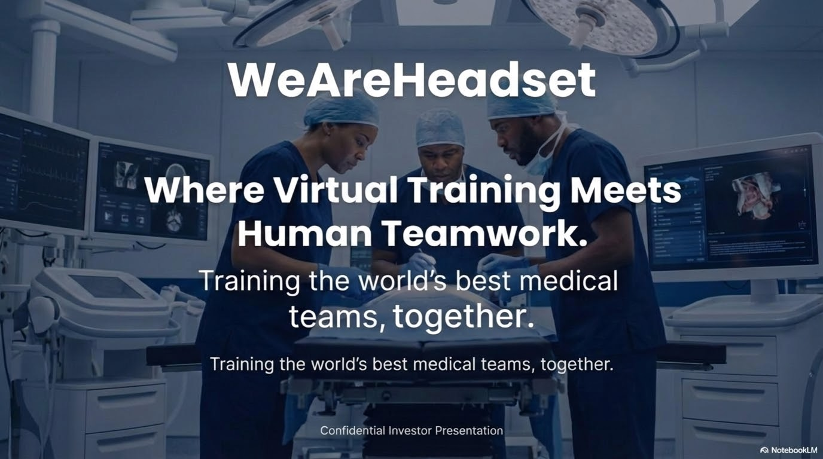
Notes:
Who we are (team of 4 software engineering students).
Short mission statement: improving the future of medical team training.
Brief setup: “Healthcare training has a major problem/room for improvement and we believe technology can fix it.”

Slide 2
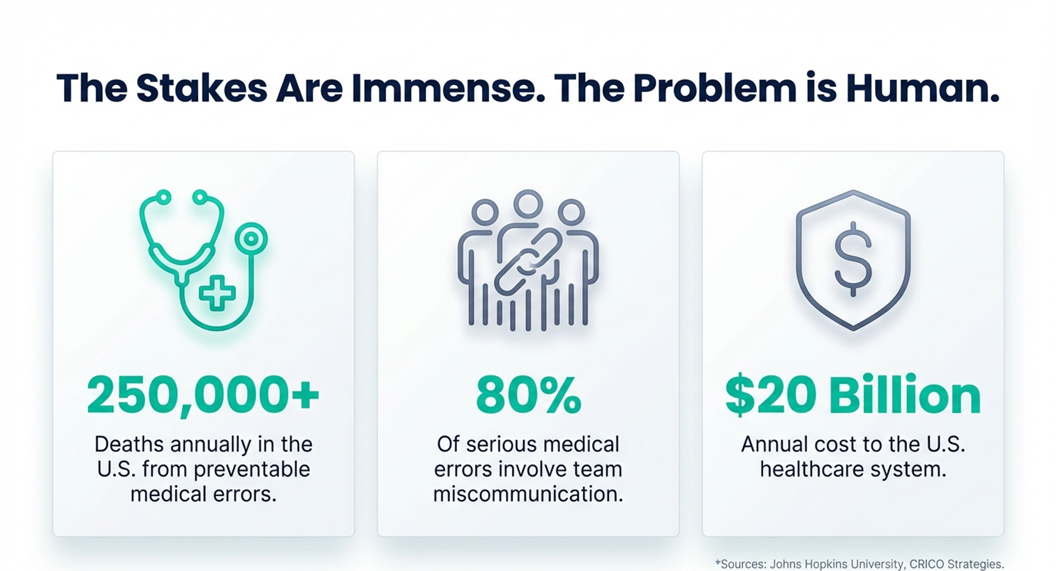
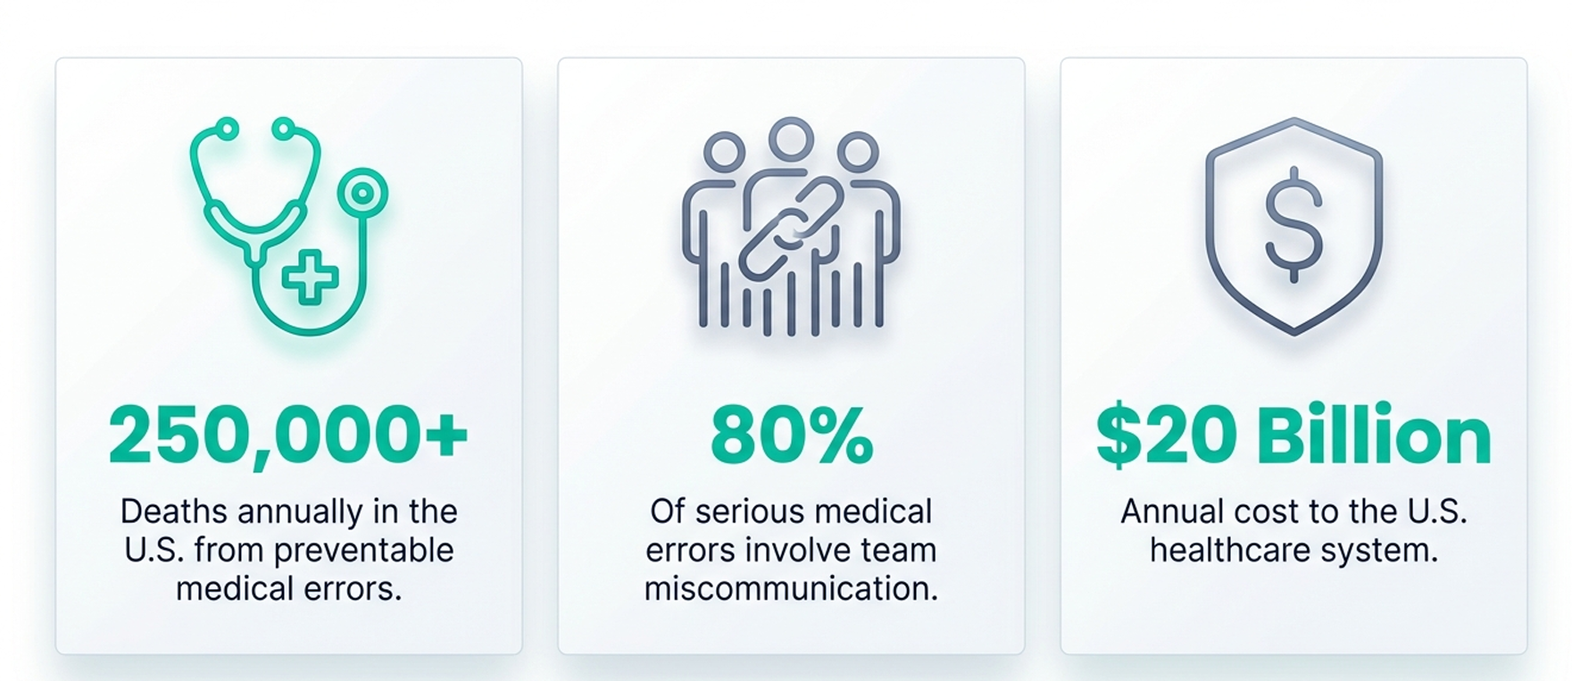
The Stakes Are Immense. The Problem is Human.
The Stakes Are Immense. The Problem is Human.
+sources: Johns Hopkins University, CRICO Strategies.
Notes:
Medical errors = massive impact (Johns Hopkins etc.).
Many errors stem from team dynamics, miscommunication, stress.
Training today doesn’t prepare teams for unpredictable, high-pressure real events.
Reinforce the idea that despite high stakes, training realism is low.
Visual emphasis: life-or-death consequences → poor preparation.

Slide 3
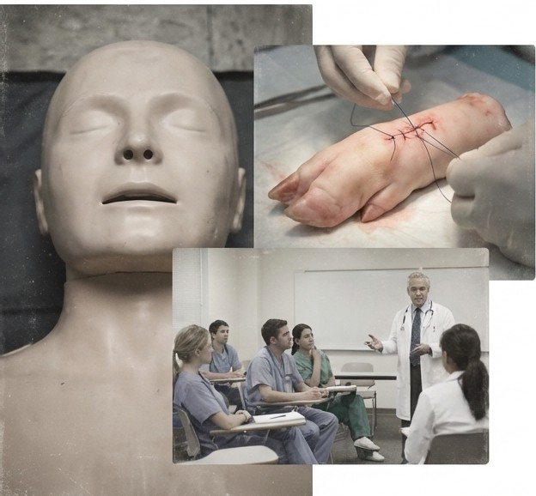
Today's Training is a Low-Fidelity Dress Rehearsal for a High-Stakes Reality
"You stand there working on a plastic dummy... you know the real situation is nothing like this. My biggest fear is that I won't know what to do because my training hasn't prepared me for the stress."
- Jakob, Medical Student
"I can't think of any targeted training we've had for handling critical situations as a team. You just learn on the job, which isn't ideal for anyone."
- Sebastian, Medical Student
"My biggest concern is: can I act correctly when I'm stressed? Will I be able to think clearly enough to save the patient when it's not a drill?"
- Simone, Nurse
Notes:
Mannequin training = unrealistic, emotionally flat.
Medical students/nurses’ quotes: fear of not being ready; stress not replicated.
“Learning on the job” → unsafe for both clinicians and patients.
Gap between simulation and real emergency teamwork.

Slide 4

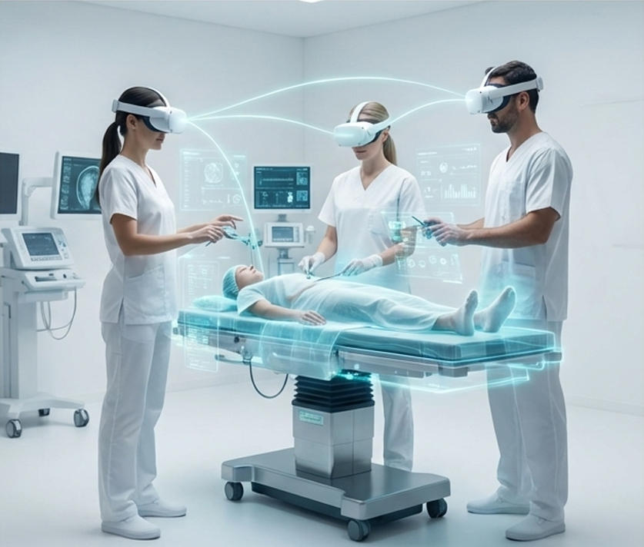


The Realism of VR. The Dynamics of Real-World Teamwork.
Hyper-Realistic Scenarios
Train for high-risk, low-frequency emergencies in a safe, repeatable environment.
True Team Interaction
Develop communication and muscle memory by working side-by-side with your actual team in the same physical space.
Actionable Performance Analytics
Capture team and individual performance data to identify and close critical skill gaps.
Notes:
Why VR is the right tool now (high fidelity, affordable hardware, immersion).
Hyper-realistic emergency scenarios.
True team interaction: people train as a group, not individually.
Performance analytics: objective improvement, trackable over time.

Slide 5
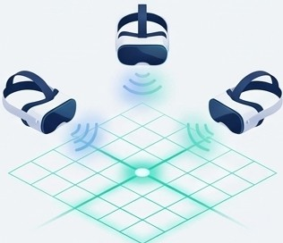
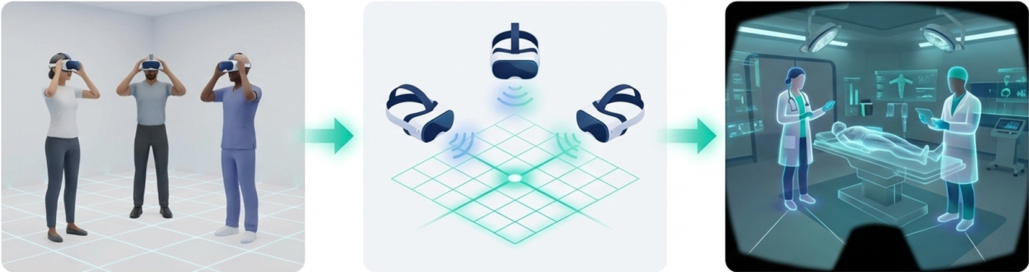
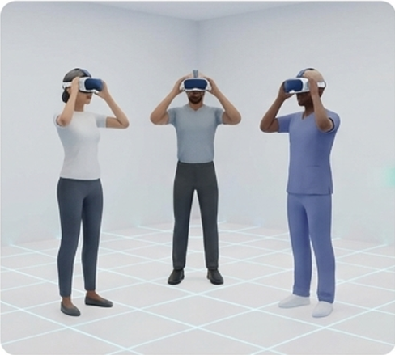




How It Works: Shared Space, Shared Experience
1. Physical Co-location
Team members are in the same physical room, allowing for natural communication and movement.
2. Shared Spatial Anchors
Using proven Meta XR technology, we create a persistent, shared coordinate system, mapping the virtual world precisely onto the physical space.
3. Seamless Collaboration
The team interacts with each other and the virtual patient as if they were in a real operating room.
Notes:
Physical co-location: same room → natural communication and movement.
Shared spatial anchors: tech ensures VR room perfectly matches real room.
Shared experience feels like a real OR.
Encourage understanding that: this is not isolated VR; it is collaborative VR.

Slide 6
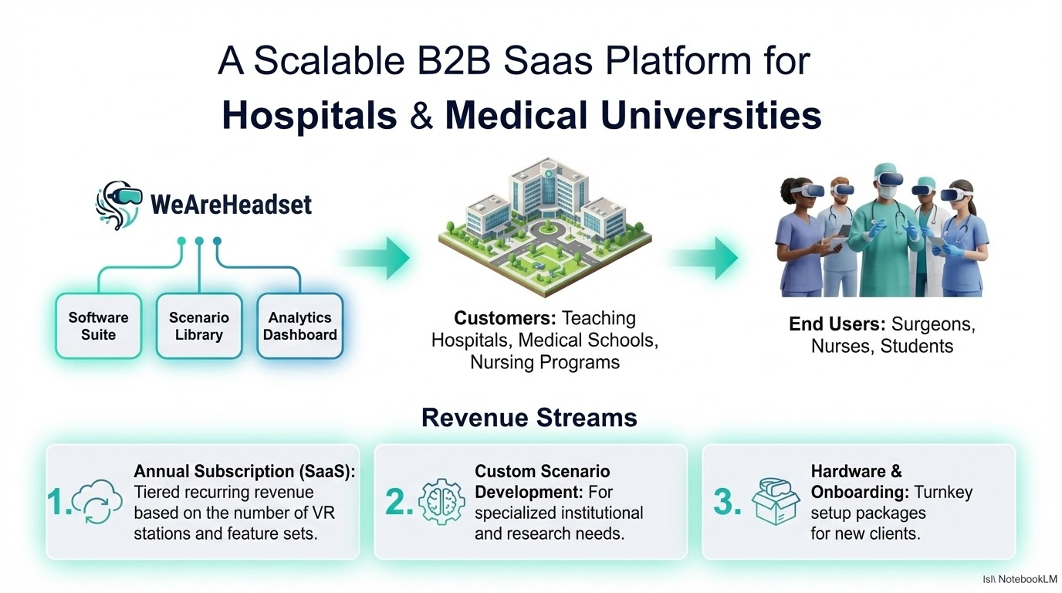
Notes:
This is not just one VR scenario → it’s a scalable software platform.
Hospitals subscribe and get: Scenario library Updates & analytics Support for multiple departments
Low hardware requirements → high scalability.
Predictable recurring revenue model (B2B SaaS).
Easier rollouts because it uses existing XR hardware ecosystems.
Sets the foundation for your business growth model

Slide 7
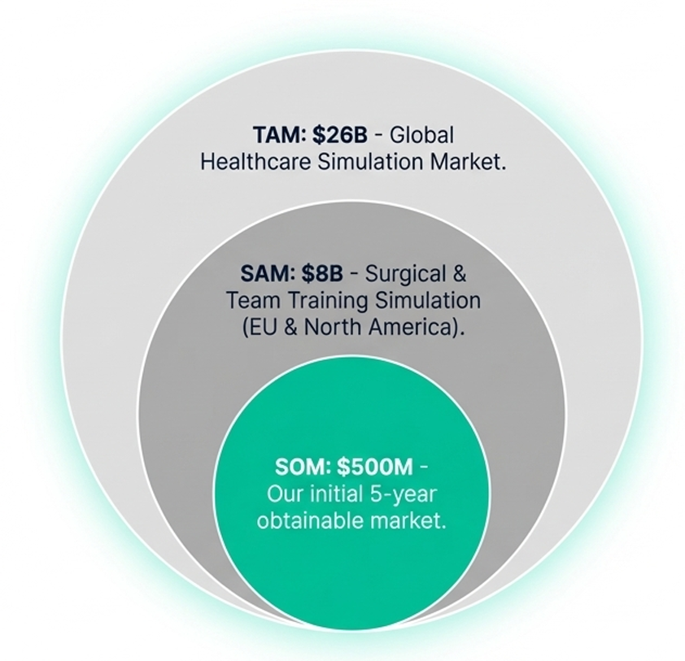




Targeting the $2.6B Medical Simulation Market with a Focused Strategy.
Our Bottom-Up Logic
Target Institutions: 2,500 top-tier teaching hospitals & universities.
Our Goal: Capture 100 institutions.
Avg. Contract Value: €50k/year.
Year 5 ARR: €5M (with clear expansion potential within accounts).
=�=
0 ODO 0
0 _{m} 0
Notes:
Medical simulation is a large and growing market.
Fragmented, dominated by outdated physical simulators.
Opportunity for high-realism, tech-driven team-based training
Targeting 2,500 top-tier hospitals/universities.
Goal: acquire 100 institutions.
Clear calculation: €50k per institution → €5M ARR potential in year 5.
Why this is realistic: high budgets for emergency training & accreditation
.

Slide 8
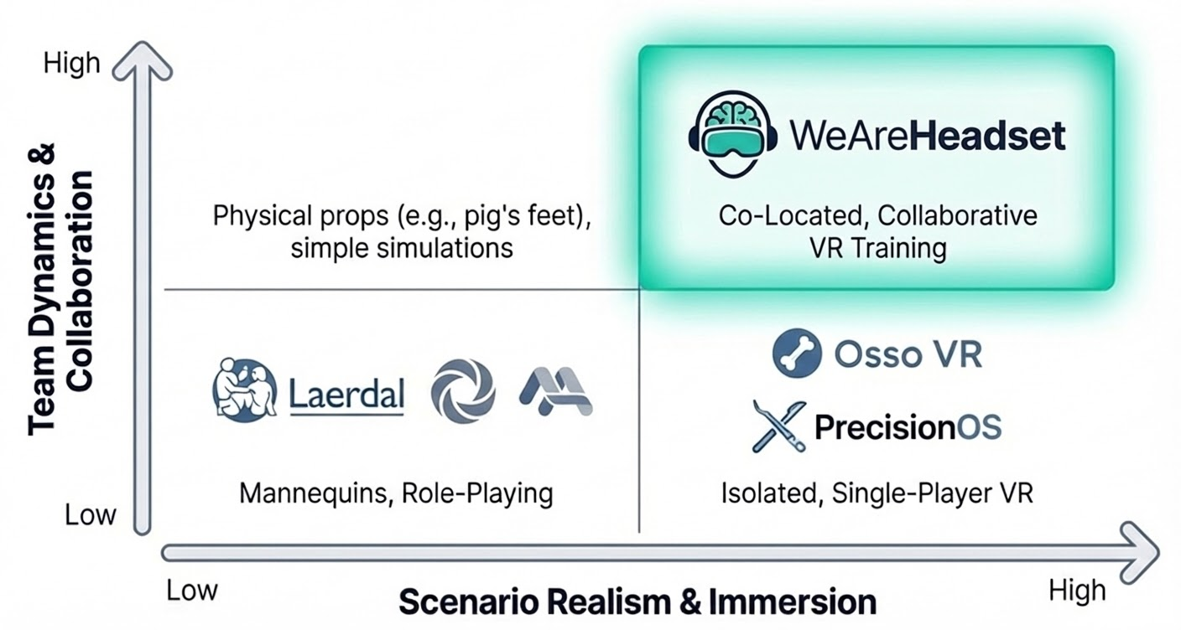

We Aren't Just Better, We're Different.
Notes:
Not just VR training — this is team-based XR simulation.
Competitors: typically solo VR or physical mannequins.
Unique value: real-time team coordination in shared VR space.

Slide 9
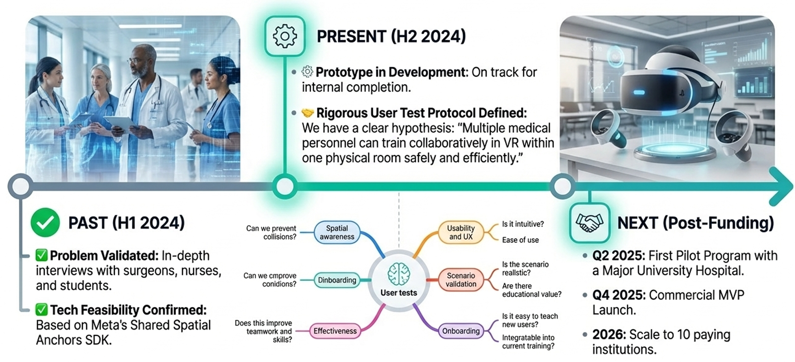
From Validation to a Clear Path Forward.
PRESENT (Q4 2025)
PAST (Q3 2025)
Q2 2026: First Pilot Program with a Major University Hospital.
Q4 2026: Commercial MVP Launch.
2027: Scale to 10 paying institutions.
Notes:
Past (Q3 2025): user interviews, early prototypes, tech validation.
Present (Q4 2025): refining shared-space tech + scenario design.
Future milestones:
Q2 2026: pilot at major university hospital.
Q4 2026: commercial MVP.
2027: scale to 10 paying institutions.

Slide 10
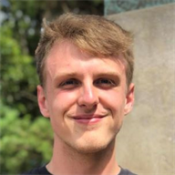
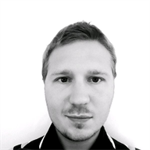

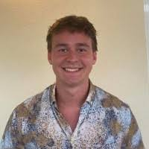

The Right Team to Bridge Healthcare and Technology
Sebastian, Founder
Bachelor in Software Engineering, Master Student
Seibert Solutions Denmark, Danmarks Frie Forskningsfond
Jon, Founder
Bachelor in Software Engineering, Master Student
Bankdata
Sebastian, Founder
Bachelor in Software Engineering, Master Student
B2B Promotion Danmark
Kasper, Founder
Bachelor in Software Engineering, Master Student
Vitec Aloc, SDU (Nudge2Green)
Notes:
four Software Engineering bachelor graduates, now Master students. Mix of strong technical backgrounds + practical work experience.
Introduce each team member briefly job besides education:
Kasper
Sebastian J
Sebastian h
Jon
Wrap-up theme:
Complementary skill sets: software development, system design, XR development, product thinking.
Collective ambition: deliver a high-quality technical proof-of-concept grounded in real healthcare needs.

Slide 11
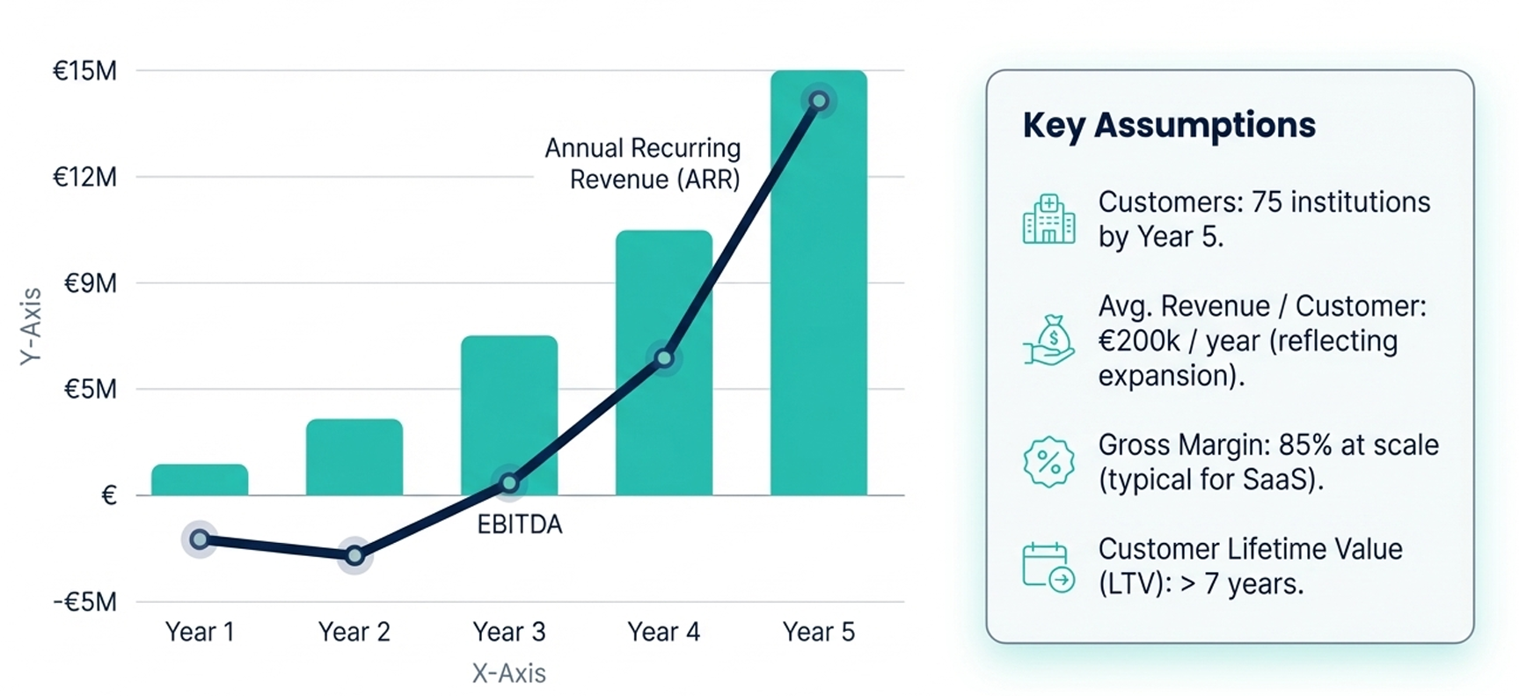
A Capital-Efficient Path to Profitability and €15M in ARR
Notes:
Software-first approach → high scalability.
Low hardware cost vs traditional simulators → compelling ROI.
Strong potential for recurring revenue via subscription/licensing.

Slide 12
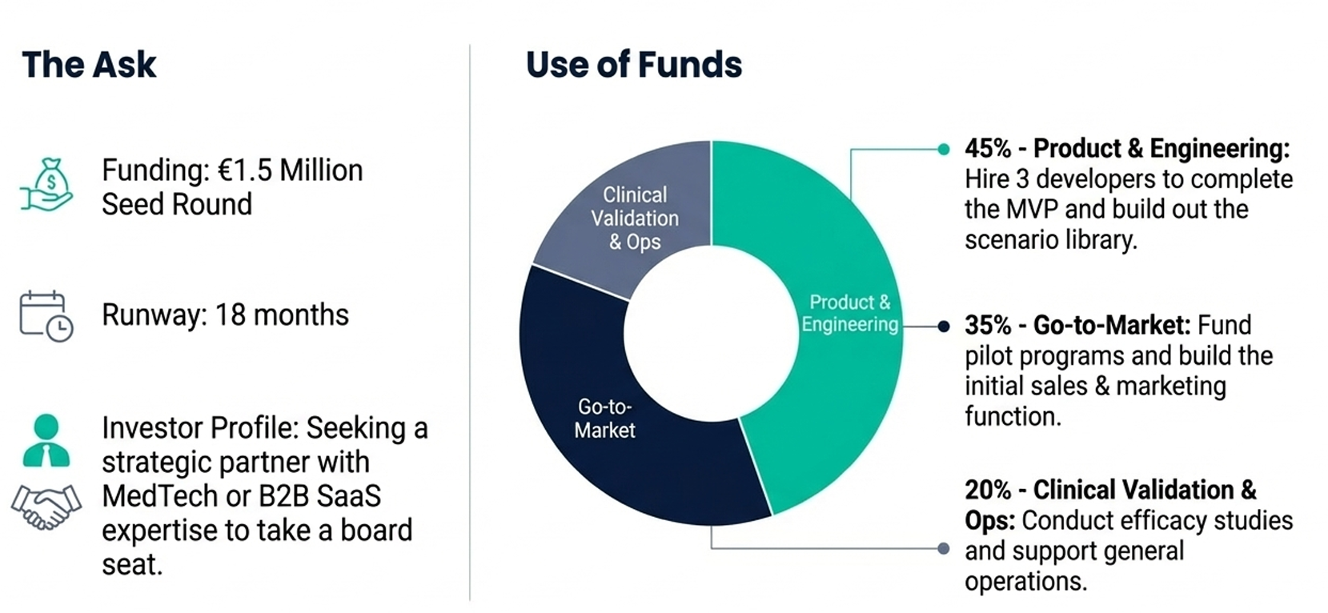
Seeking a Partner to Revolutionize Medical Training.
Notes:
Vision: safer patient outcomes through better-prepared medical teams.
Why now: technology is ready, demand is growing, training gaps remain huge.
What you want: a partner who believes in transforming medical education.
Close with a strong call to action and thank you.

Slide 13
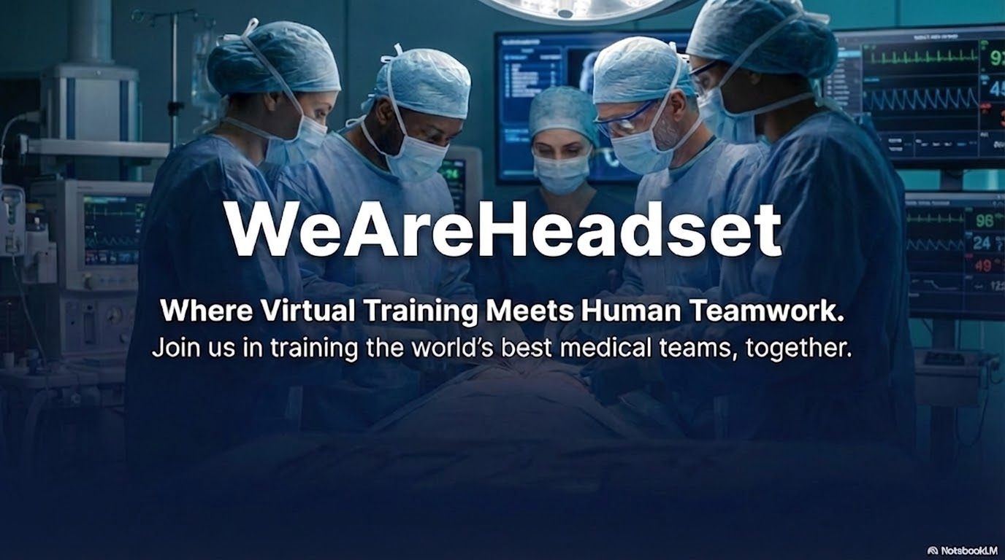
Notes:
Thanks!

